Slide 1

Automatic Alternative Image Recognition to Voice

Slide 2
Phan Trung Thành (Leader)
Nguyễn Vũ Hoàng Sơn
Võ Hà Quân
Nguyễn Cao Duy (Dropped Out)
Supervisor
Kiều Trọng Khánh

Slide 3
Outline
01
01
Problem
02
Our Solution
03
Main features
04
Future plan
05
Technologies - Devlopment Environment

Slide 4
Introduction
Problems

Slide 5
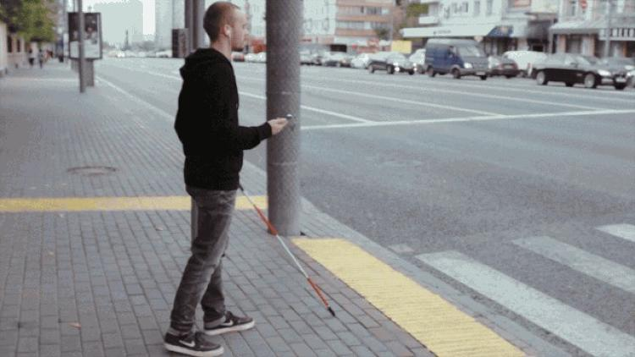
Automatic Alternative Image Recognition to Voice
What problems that blind People face in life ?
Self-navigating outside well-known environments
Notes:
Objects obstacles.
Traveling
Walking on street

Slide 6
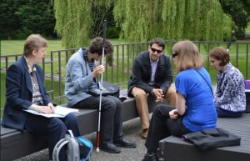
Automatic Alternative Image Recognition to Voice
What problems that blind People face in life ?
Self-navigating outside well-known environments.
Social challenges.
Notes:
Meeting people
Participate in activities
=> Low self esteem

Slide 7
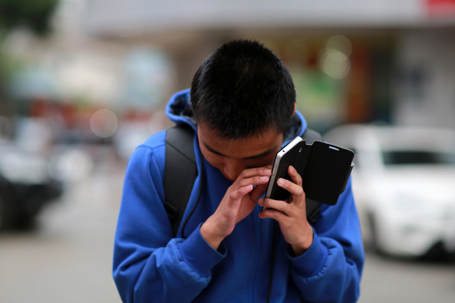
Automatic Alternative Image Recognition to Voice
What problems that blind People face in life ?
Self-navigating outside well-known environments.
Social challenges.
Technologies using difficulty

Slide 8
Common Solutions

Slide 9
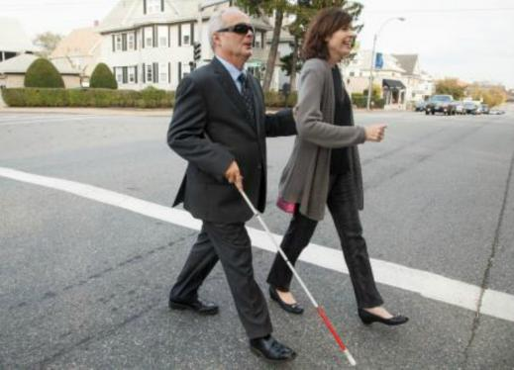
Common Solutions
Helpers

Slide 10
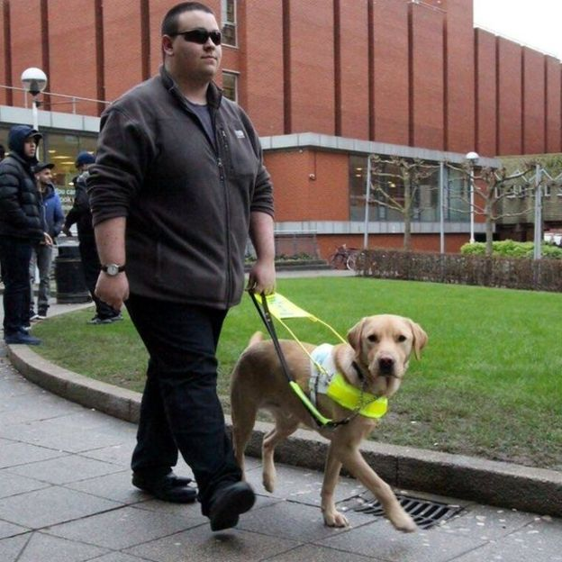
Common Solutions
Helpers
Walking Dogs

Slide 11
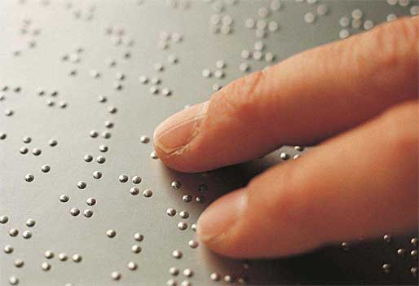
Common Solutions
Helpers
Walking Dogs
Braille

Slide 12
Introduction
Our Solution

Slide 13


Automatic Alternative Image Recognition to Voice
Our Solution
See4U – A Portable Assistance for Blind Person

Slide 14
Automatic Alternative Image Recognition to Voice
Our Solution
See4U – A Portable Assistance for Blind Person

Slide 15

Automatic Alternative Image Recognition to Voice
Our Solution
See4U – A Portable Assistance for Blind Person

Slide 16

Our Solution
See4U helps blind people to recognize their friends and family
Identify Person
Notes:
#chua noi den voice regconition

Slide 17

Our Solution
See4U can identify common Objects around the house
Identify Person
Identify Objects
Notes:
#chua noi den voice regconition

Slide 18
Our Solution
You can teach See4U to be smarter everyday
Identify Person
Identify Objects
Training
Notes:
#chua noi den voice regconition

Slide 19

Our Solution
Blind Person will control the application
through voice commands
Identify Person
Identify Objects
Training
Voice Control
Notes:
#chua noi den voice regconition

Slide 20

Automatic Alternative Image Recognition to Voice
Scopes
Blind Person
Blind’s Partner
Notes:
#nhung nguoi dung he thong

Slide 21


Automatic Alternative Image Recognition to Voice
Roles
Member
Admin

Slide 22



Automatic Alternative Image Recognition to Voice
Roles
Detect Person
Detect Object
Train Person
Member
Control by Voice

Slide 23


Automatic Alternative Image Recognition to Voice
Roles
Account Management
Train Object
Manage Objects
Admin

Slide 24
Person
Identification
Introduction

Slide 25
Person Identification
Scenario

Slide 26
Person Identification
Scenario
Mr. Son is a blind person. He is walking on the street when suddenly run into his friend, Mr. Thanh.
Mr. Son

Slide 27

Person Identification
Scenario
Mr. Thanh says “Hello” to Mr. Son
Mr. Son
Mr. Thanh

Slide 28
Person Identification
Scenario
Mr. Thanh says “Hello” to Mr. Son
Hello !
Mr. Son
Mr. Thanh

Slide 29
Person Identification
Scenario
Who is that ?
It is common sense that Mr. Son will wonder: “Who is that ?”
Mr. Son

Slide 30
Person Identification
Problem
Who is that ?
How can Mr. Son knows who is the person calling him ?
Notes:
Làm sao biết người đang gọi mình là ai
Làm sao chào hỏi người đó như thế nào

Slide 31
Person Identification
Problem
Who is that ?
How can Mr. Son knows who is the person calling him ?
How can Mr. Son greet that person ?
Notes:
Làm sao biết người đang gọi mình là ai
Làm sao chào hỏi người đó như thế nào

Slide 32
Person Identification
Our Proposal

Slide 33

Person Identification
Our Proposal
System

Slide 34
Person Identification
Our Proposal
Detect Person
System

Slide 35
Person Identification
Our Proposal
Describe the Person back to the blind
Detect Person
System

Slide 36
Person Identification
Our Proposal
Describe the Person back to the blind
Detect Person
System
The blind know who is the Person calling them

Slide 37
Person Identification
Our Proposal
Describe the Person back to the blind
Detect Person
System
User can now greeting the person properly
The blind know who is the Person calling them

Slide 38
Person Identification
How can we do that ?

Slide 39

Person Identification
How can we do that ?
Device Camera

Slide 40
Person Identification
How can we do that ?
Device Camera
Capture picture of the Person

Slide 41
Person Identification
How can we do that ?
Device Camera
System
Capture picture of the Person

Slide 42
Person Identification
How can we do that ?
Device Camera
System
Capture picture of the Person
Process

Slide 43

Person Identification
How can we do that ?
Device Camera
System
Image Recognizer
Capture picture of the Person
Process

Slide 44
Person Identification
How can we do that ?
Device Camera
System
Image Recognizer
Capture picture of the Person
Process
Facial Identification

Slide 45

Person Identification
How can we do that ?
1. Capture Picture
Device Camera
Notes:
Qui trình như sau

Slide 46
Person Identification
How can we do that ?
1. Capture Picture
Device Camera
System

Slide 47
Person Identification
How can we do that ?
2. Send Image
1. Capture Picture
Device Camera
System
Image Recognizer

Slide 48
Person Identification
How can we do that ?
2. Send Image
1. Capture Picture
Device Camera
System
3. Response Result
Image Recognizer

Slide 49

Person Identification
How can we do that ?
2. Send Image
1. Capture Picture
Device Camera
System
3. Response Result
Image Recognizer
4. Process

Slide 50

Person Identification
How can we do that ?
2. Send Image
1. Capture Picture
Device Camera
System
3. Response Result
Image Recognizer
4. Process
5. Describe
Blind user

Slide 51

Person Identification
How can we do that ?
2. Send Image
1. Capture Picture
Device Camera
System
3. Response Result
Image Recognizer
4. Process
5. Describe
Blind user

Slide 52
Person Identification
Technology
After spent times studying, we decided to use Microsoft Cognitive Service to be our Image Recognizer because its features is suitable for our approach.

Slide 53

Person Identification
Technology
Why do we choose Microsoft Cognitive Service ?

Slide 54
Person Identification
Technology
Why do we choose Microsoft Cognitive Service ?
Detect Human Faces, Gender, Age

Slide 55
Person Identification
Technology
Why do we choose Microsoft Cognitive Service ?
Detect Human Faces, Gender, Age
Train system to identify a Person

Slide 56
Person Identification
Technology
Why do we choose Microsoft Cognitive Service ?
Detect Human Faces, Gender, Age
Train system to identify a Person
Identify Person Face

Slide 57
Person Identification
Technology
How can a machine detect a Human Face ?

Slide 58
Person Identification
Technology
Understand a Human Face

Slide 59

Person Identification
Technology
Understand Human Face
This is how we see a Human Face

Slide 60
Person Identification
Technology
Understand Human Face
This is how we see a Human Face
Eyes

Slide 61
Person Identification
Technology
Understand Human Face
This is how we see a Human Face
Eyes
Nose

Slide 62
Person Identification
Technology
Understand Human Face
This is how we see a Human Face
Eyes
Nose
Mouth

Slide 63
Person Identification
Technology
Understand Human Face
We do this automatically
and instantly !

Slide 64
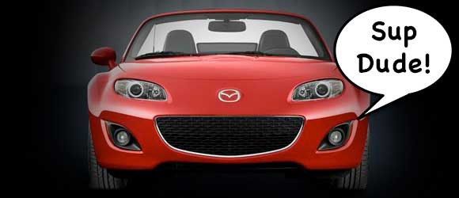
Person Identification
Technology
Understand Human Face
In fact, we are too good at it that we end up seeing faces in everyday objects.

Slide 65
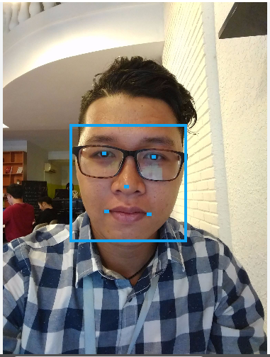
Person Identification
Technology
Understand Human Face
And this is how a Computer will see our Human Face.

Slide 66
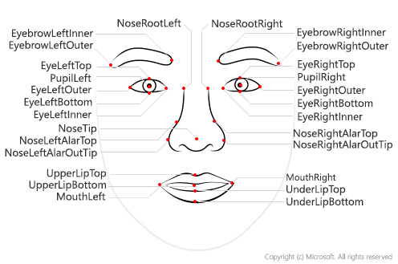
Person Identification
Technology
Understand Human Face

Slide 67
Person Identification
Technology
Facial Detection - How it works

Slide 68
Person Identification
Technology
To detect a Human Face, we use the method called “Histogram of Oriented Gradients”.

Slide 69
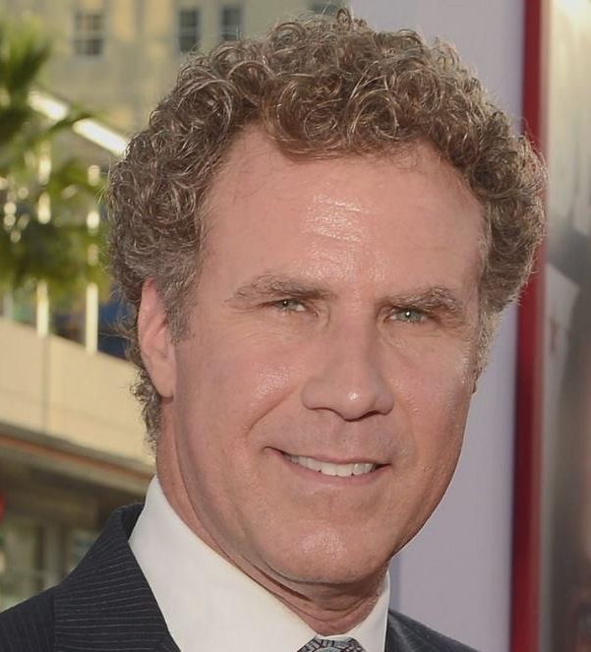
Person Identification
Technology
Facial Detection - How it works
Input

Slide 70
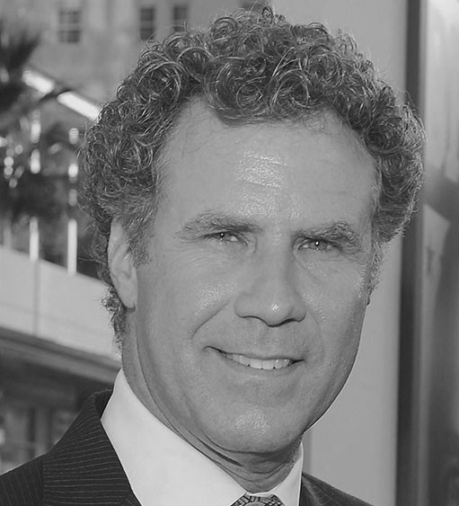
Person Identification
Technology
Facial Detection - How it works
Input
Convert to black and white

Slide 71
Person Identification
Technology
Facial Detection - How it works
Computers do not need color data to detect faces
Input
Convert to black and white

Slide 72
Person Identification
Technology
Facial Detection - How it works
Then we look at every single pixel of the image.
For each of the pixel, we want to look at the pixels directly surrounding it.

Slide 73
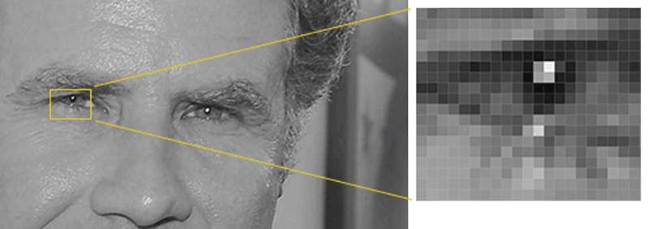
Person Identification
Technology
Facial Detection - How it works
Then we look at every single pixel of the image.
For each of the pixel, we want to look at the pixels directly surrounding it.

Slide 74
Person Identification
Technology
Facial Detection - How it works
Then we want to draw an arrow showing in which direction the image is getting darker.

Slide 75

Person Identification
Technology
Facial Detection - How it works
Then we want to draw an arrow showing in which direction the image is getting darker.

Slide 76
Person Identification
Technology
Facial Detection - How it works
Repeat that process for every single pixel in the image, you end up with every pixel being replaced by an arrow.

Slide 77

Person Identification
Technology
Facial Detection - How it works
Repeat that process for every single pixel in the image, you end up with every pixel being replaced by an arrow.
Notes:
If we analyze pixels directly, really dark images and really light images of the same person will have totally different pixel values. But by only considering the direction that brightness changes, both really dark images and really bright images will end up with the same exact representation. That makes the problem a lot easier to solve!

Slide 78
Person Identification
Technology
Facial Detection - How it works
Break up the image into small squares of 16x16 pixels each. In each square, we’ll count up how many gradients point in each major direction.

Slide 79
Person Identification
Technology
Facial Detection - How it works
Break up the image into small squares of 16x16 pixels each. In each square, we’ll count up how many gradients point in each major direction.
Then replace that square in the image with the arrow directions that were the strongest.

Slide 80

Person Identification
Technology
Facial Detection - How it works
This is how it looks like:

Slide 81
Person Identification
Technology
Facial Detection - How it works
Then to find out the Human Face, we have to find the part of our image that looks the most similar to a known HOG pattern that was extracted from a bunch of other training faces.

Slide 82
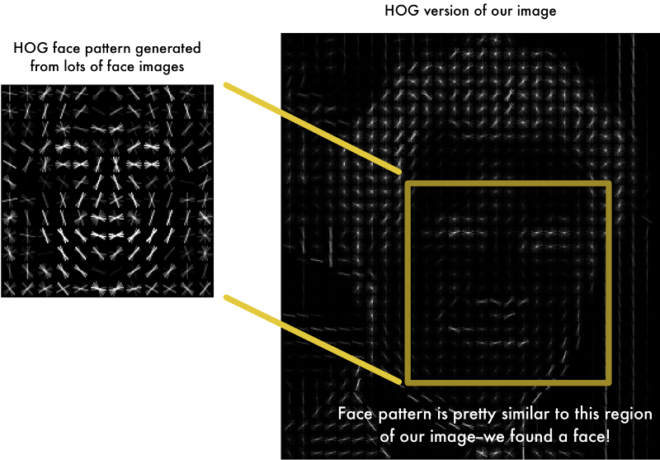
Person Identification
Technology
Facial Detection - How it works

Slide 83
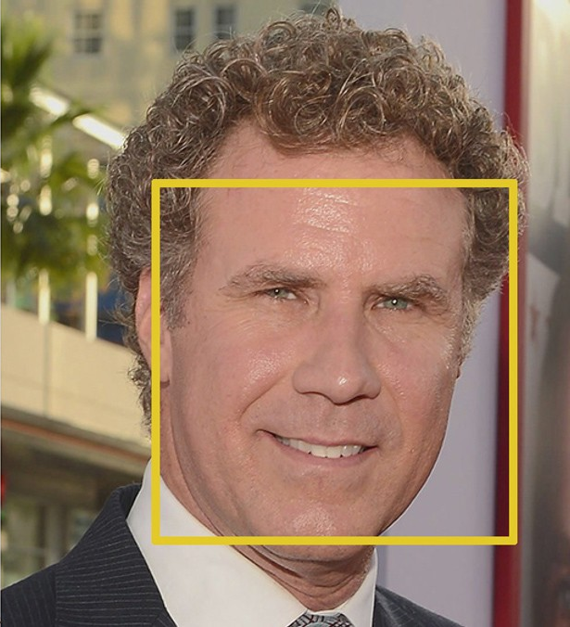
Person Identification
Technology
Facial Detection - How it works
Voila, a Face is found !

Slide 84
Person Identification
Technology
How can Microsoft Cognitive Service
recognizes who is who ?

Slide 85
Person Identification
Technology
Before Microsoft Cognitive Service can Identify a Person, we will have to teach it who are they first.

Slide 86
Person Identification
Technology
Before Microsoft Cognitive Service can Identify a Person, we will have to teach it who are they first.
This is called the “Training” process.

Slide 87
Person Identification
Technology
The Training Process

Slide 88
Person Identification
Technology
Training Process
Create New Person

Slide 89
Person Identification
Technology
Training Process
Create New Person
Add Person Face

Slide 90
Person Identification
Technology
Training Process
Create New Person
Add Person Face
Training

Slide 91
Person Identification
Technology
Understand Terms

Slide 92
Person Identification
Technology
Understand Terms
Person Group

Slide 93
Person Identification
Technology
Understand Terms
Person Group
Person

Slide 94
Person Identification
Technology
Understand Terms
Person Group
Person
Face

Slide 95
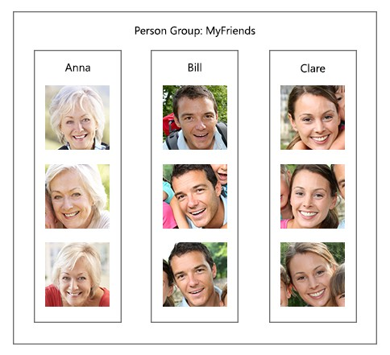
Person Identification
Understand Terms
Person Group
Notes:
Một nhóm gồm nhiều người được tập trung lại

Slide 96
Person Identification
Understand Terms
Person Group
Most important

Slide 97
Person Identification
Understand Terms
Person Group
Most important
Unique for each user

Slide 98
Person Identification
Understand Terms
Person Group
Most important
Unique for each user
Contains up to 1000 Person

Slide 99
Person Identification
Understand Terms
Person

Slide 100
Person Identification
Understand Terms
Person
Belong to an unique Person Group

Slide 101
Person Identification
Understand Terms
Person
Belong to an unique Person Group
Have an unique Person ID

Slide 102
Person Identification
Understand Terms
Person
Belong to an unique Person Group
Have an unique Person ID
Have Name, Description

Slide 103
Person Identification
Understand Terms
Person
Belong to an unique Person Group
Have an unique Person ID
Have Name, Description
Have up to 248 faces.

Slide 104
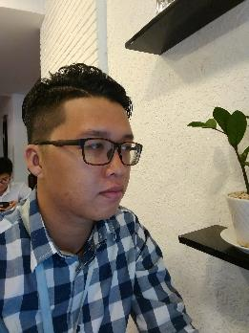


Person Identification
Understand Terms
Face
Have an unique Persisted Face ID
Hà Quân

Slide 105
Person Identification
Understand Terms
Face
Have an unique Persisted Face ID
Belong to a certain Person
Hà Quân

Slide 106
Person Identification
Technology
Summary –Terms

Slide 107
Person Identification
Technology
Summary –Terms
A User will have an unique Person Group.
Person Group

Slide 108
Person Identification
Technology
Summary –Terms
A User will have an unique Person Group.
A Person Group will contains different People.
Person Group
Person

Slide 109
Person Identification
Technology
Summary –Terms
A User will have an unique Person Group.
A Person Group will contains different People.
Each Person will have their own Faces.
Person Group
Person
Faces

Slide 110
Person Identification
Technology
Training Process
Create New Person
Add Person Face
Training

Slide 111
Person Identification
Technology
Training Process
Create New Person
Add Person Face
Training

Slide 112
Person Identification
Create New Person
Microsoft Cognitive Service
System
User

Slide 113
Person Identification
Create New Person
Microsoft Cognitive Service
System
1. Input
User
Name
Description

Slide 114
Person Identification
Create New Person
Microsoft Cognitive Service
System
Person Group
Person
1. Input
Name
Description
User
Name
Description

Slide 115
Person Identification
Create New Person
Microsoft Cognitive Service
System
Person Group
Person
2. Create Person
1. Input
Name
Description
User
Name
Description

Slide 116
Person Identification
Create New Person
Microsoft Cognitive Service
System
Person Group
Person Group
Person
Person
2. Create Person
1. Input
Name
Description
Name
Description
Person ID
User
Name
Description

Slide 117
Person Identification
Create New Person
Microsoft Cognitive Service
System
Person Group
Person Group
Person
Person
2. Create Person
1. Input
Name
Description
Name
Description
Person ID
User
Name
Description
3. Person ID

Slide 118
Person Identification
Create New Person
Microsoft Cognitive Service
System
Person Group
Person Group
Person
Person
2. Create Person
1. Input
Name
Description
Person ID
Name
Description
Person ID
User
Name
Description
3. Person ID

Slide 119
Person Identification
Technology
Training Process
Create New Person
2. Add Person Face
3. Training

Slide 120
Person Identification
Technology
Training Process
Create New Person
2. Add Person Face
3. Training

Slide 121
Person Identification
Add Person Face
Microsoft Cognitive Service
System
Person Group
Person Group
Person
Person
Name
Description
Person ID
Name
Description
Person ID
User

Slide 122

Person Identification
Add Person Face
Microsoft Cognitive Service
System
Person Group
Person Group
1. Input
Person
Person
Name
Description
Person ID
Name
Description
Person ID
User

Slide 123
Person Identification
Add Person Face
Microsoft Cognitive Service
System
Person Group
Person Group
1. Input
Person
2. Send
Person
Name
Description
Person ID
Name
Description
Person ID
User
Person ID
Person Group ID

Slide 124
Person Identification
Add Person Face
Microsoft Cognitive Service
System
Person Group
Person Group
1. Input
Person
2. Send
Person
Name
Description
Person ID
Name
Description
Person ID
User
Person ID
Person Group ID
Face

Slide 125
Person Identification
Add Person Face
Microsoft Cognitive Service
System
Person Group
Person Group
1. Input
Person
2. Send
Person
Name
Description
Person ID
Name
Description
Person ID
User
Person ID
Person Group ID
Face
3. Return
Persisted Face ID

Slide 126
Person Identification
Add Person Face
Microsoft Cognitive Service
System
Person Group
Person Group
1. Input
Person
2. Send
Person
Name
Description
Person ID
Name
Description
Person ID
User
Person ID
Face
Face
Person Group ID
Persisted Face ID
3. Return
Persisted Face ID

Slide 127
Person Identification
Technology
Training Process
Create New Person
Add Person Face
3. Training

Slide 128
Person Identification
Technology
Training Process
Create New Person
Add Person Face
3. Training

Slide 129
Person Identification
Training
Microsoft Cognitive Service
System
Person Group
User

Slide 130
Person Identification
Training
Microsoft Cognitive Service
System
Person Group
1. Train
User

Slide 131
Person Identification
Training
Microsoft Cognitive Service
System
Person Group
2. Send
1. Train
Person Group ID
User

Slide 132

Person Identification
Training
Microsoft Cognitive Service
System
Person Group
Person Group
2. Send
1. Train
Person Group ID
User
Train Person Group

Slide 133
Person Identification
Training
Microsoft Cognitive Service
System
Person Group
Person Group
2. Send
1. Train
Person Group ID
User
3. Return Status
4. Notify
Train Person Group

Slide 134
Person Identification
Technology
Training Process
Create New Person
Add Person Face
Training

Slide 135
Person Identification
Demo
Training a Person

Slide 136
Person Identification
Summary – Demo Training Unidentified Person

Slide 137
Person Identification
Summary – Demo Training Unidentified Person
New Person is successfully added into system.

Slide 138
Person Identification
Summary – Demo Training Unidentified Person
New Person is successfully added into system.
System can now Identify trained Person.

Slide 139
Person Identification
Technology
After the training process, the System can now identify the Person, even with different image of them.

Slide 140
Person Identification
Technology
After the training process, the System can now identify the Person, even with different image of them.
This is called the “Identifying” process.

Slide 141
Person Identification
Technology
The Identifying Process

Slide 142
Person Identification
Technology
Identifying Process
Detect Human Face

Slide 143
Person Identification
Technology
Identifying Process
Detect Human Face
Identify Face and get Candidates

Slide 144
Person Identification
Technology
Identifying Process
Detect Human Face
Identify Face and get Candidates
Get Person Information

Slide 145
Person Identification
Technology
Identifying Process
Detect Human Face
Identify Face and get Candidates
Get Person Information

Slide 146
Person Identification
Detect Human Face
Microsoft Cognitive Service
System
User

Slide 147

Person Identification
Detect Human Face
Microsoft Cognitive Service
System
1. Capture
User

Slide 148

Person Identification
Detect Human Face
Microsoft Cognitive Service
System
1. Capture
2. Detect API
User

Slide 149
Person Identification
Detect Human Face
Microsoft Cognitive Service
System
1. Capture
2. Detect API
User

Slide 150
Person Identification
Detect Human Face
Microsoft Cognitive Service
System
1. Capture
2. Detect API
User

Slide 151
Person Identification
Detect Human Face
Microsoft Cognitive Service
System
1. Capture
2. Detect API
User
Face ID

Slide 152
Person Identification
Detect Human Face
Microsoft Cognitive Service
System
1. Capture
2. Detect API
User
3. Return
Face ID
Face ID

Slide 153
Person Identification
Detect Human Face
Microsoft Cognitive Service
System
Face ID
1. Capture
2. Detect API
User
3. Return
Face ID
Face ID

Slide 154
Person Identification
Technology
Identifying Process
Detect Human Face
2. Identify Face and get Candidates
3. Get Person Information

Slide 155
Person Identification
Technology
Identifying Process
Detect Human Face
2. Identify Face and get Candidates
3. Get Person Information

Slide 156
Person Identification
Identify Face and Get Candidates
Microsoft Cognitive Service
System
Face ID
Person Group
User

Slide 157
Person Identification
Identify Face and Get Candidates
Microsoft Cognitive Service
System
Face ID
Person Group
2. Detect API
Face ID
Person Group ID
User

Slide 158
Person Identification
Identify Face and Get Candidates
Microsoft Cognitive Service
System
Face ID
Person Group
2. Detect API
Person Group
Face ID
Person Group ID
User

Slide 159
Person Identification
Identify Face and Get Candidates
Microsoft Cognitive Service
System
Face ID
Person Group
2. Detect API
Person Group
Face ID
Person Group ID
User
Candidates

Slide 160
Person Identification
Identify Face and Get Candidates
Microsoft Cognitive Service
System
Face ID
Person Group
2. Detect API
Person Group
Face ID
Person Group ID
User
3. Return
Candidates
Person ID
Confidence

Slide 161
Person Identification
Identify Face and Get Candidates
Microsoft Cognitive Service
System
Face ID
Confidence Rate:
Similarity between two Faces.
Range [0, 1]
Person Group
2. Detect API
Person Group
Face ID
Person Group ID
User
3. Return
Candidates
Person ID
Confidence

Slide 162
Person Identification
Identify Face and Get Candidates
Microsoft Cognitive Service
System
Face ID
Confidence Rate >= 0.65
Person Group
2. Detect API
Person Group
Face ID
Person Group ID
User
3. Return
Candidates
Person ID
Confidence

Slide 163
Person Identification
Identify Face and Get Candidates
Microsoft Cognitive Service
System
Face ID
2. Detect API
Person Group
Person ID
Confidence >= 0.65
Face ID
Person Group ID
User
3. Return
Candidates
Person ID
Confidence

Slide 164
Person Identification
Technology
Identifying Process
Detect Human Face
Identify Face and get Candidates
3. Get Person Information

Slide 165
Person Identification
Technology
Identifying Process
Detect Human Face
Identify Face and get Candidates
3. Get Person Information

Slide 166
Person Identification
Get Person Information
System
Face ID
Person ID
Confidence >= 0.65
User

Slide 167
Person Identification
Get Person Information
System
Face ID
User
Person ID

Slide 168
Person Identification
Get Person Information
System
Face ID
Person
Person ID
User

Slide 169
Person Identification
Get Person Information
System
Face ID
Person
Person ID
User
Describe

Slide 170
Person Identification
Demo
Identify a Person

Slide 171
Person Identification
Summary – Demo Identify a Person
Notes:
Giải quyết được 2 vấn đề đặt ra ban đầu

Slide 172
Person Identification
Summary – Demo Identify a Person
Oh it’s
Mr. Thanh
Mr. Son is now knows who is the person calling him.

Slide 173
Person Identification
Summary – Demo Identify a Person
Hello, Thanh !
Mr. Son is now knows who is the person calling him.
He can greet him back now.

Slide 174
Person Identification
Result
Hello Thanh !
Hello !
Mr. Son
Mr. Thanh

Slide 175
Real-time
Face Recognition
Introduction

Slide 176
Person Identification
Scenario
This is great, but do I have to give the command every time ?
Notes:
Quay trở lại với vấn đề nêu trên => giờ đã có thể nhận diện được đó là ai

Slide 177
Person Identification
Problem
This is great, but do I have to give the command every time ?
Giving command every time Mr. Son meets somebody is pretty inconvenient.
Notes:
Quay trở lại với vấn đề nêu trên => giờ đã có thể nhận diện được đó là ai

Slide 178
Person Identification
Problem
This is great, but do I have to give the command every time ?
Giving command every time Mr. Son meets somebody is pretty inconvenient.
Is there a way that can help Mr. Son Identify person more comfortably ? Or “Hand-free” ?
Notes:
Quay trở lại với vấn đề nêu trên => giờ đã có thể nhận diện được đó là ai

Slide 179
Person Identification
Solution
Real-time Identification Process

Slide 180
Person Identification
Solution
Detect Person Face Continuously and
Automatically
System
Notes:
#need to talk about process of detect face???

Slide 181
Person Identification
Solution
Detect Person Face Continuously and
Automatically
Describe the Person back to the blind
System

Slide 182
Person Identification
Solution
Detect Person Face Continuously and
Automatically
Describe the Person back to the blind
System
Blind user does not have to give command every time

Slide 183
Person Identification
Solution
Detect Person Face Continuously and
Automatically
Describe the Person back to the blind
System
Blind user does not have to give command every time
Hand-free, more convenient

Slide 184
Person Identification
How can we do that ?

Slide 185
Person Identification
How can we do that ?
Continuously Streaming
Device Camera

Slide 186
Person Identification
How can we do that ?
Continuously Streaming
Detect Human Face
Device Camera

Slide 187

Person Identification
How can we do that ?
Continuously Streaming
Detect Human Face
Device Camera
Capture Picture
Microsoft Cognitive Service

Slide 188
Person Identification
How can we do that ?
Continuously Streaming
Detect Human Face
Device Camera
Capture Picture
Microsoft Cognitive Service
Response Result

Slide 189
Person Identification
How can we do that ?
Continuously Streaming
Detect Human Face
Device Camera
Capture Picture
Microsoft Cognitive Service
Response Result
Blind user

Slide 190
Person Identification
Demo
Real-time Identifying Process

Slide 191
Person Identification
Summary – Demo Real-time Identifying Process
Everything is automatic !
Notes:
Quay trở lại với vấn đề nêu trên => giờ đã có thể nhận diện được đó là ai

Slide 192
Person Identification
Summary – Demo Real-time Identifying Process
Mr. Son does not have to give command to identify every time he meets somebody.
Everything is automatic !
Notes:
Quay trở lại với vấn đề nêu trên => giờ đã có thể nhận diện được đó là ai

Slide 193
Person Identification
Summary – Demo Real-time Identifying Process
Mr. Son does not have to give command to identify every time he meets somebody.
Totally “Hand-free”.
Everything is automatic !
Notes:
Quay trở lại với vấn đề nêu trên => giờ đã có thể nhận diện được đó là ai

Slide 194
Check Duplicated Person By Faces
Introduction

Slide 195
Check Duplicated Person By Faces
Problem

Slide 196


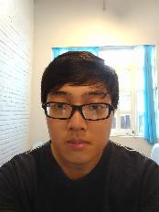
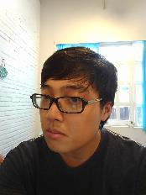
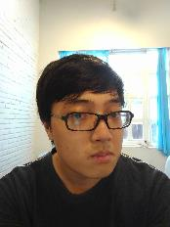
Check Duplicated Person By Faces
Problem
Person List
Ngọc Hoàng
Hoàng Sơn

Slide 197
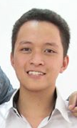
Check Duplicated Person By Faces
Problem
Person List
Ngọc Hoàng
+
Hoàng
Hoàng Sơn

Slide 198
Check Duplicated Person By Faces
Problem
Person List
Person List
Ngọc Hoàng
Ngọc Hoàng
+
Hoàng
Hoàng Sơn
Hoàng Sơn
Hoàng

Slide 199
Check Duplicated Person By Faces
Problem
Person List
Person List
Ngọc Hoàng
Ngọc Hoàng
+
Hoàng
Hoàng Sơn
Hoàng Sơn
Hoàng
Notes:
Việc có cùng 1 người mà được lưu thành nhiều person trong person list làm giảm performance của phần mềm vì khi detect người phải so sánh thêm 1 person nữa

Slide 200
Check Duplicated Person By Faces
Our Proposal

Slide 201
Check Duplicated Person By Faces
Our Proposal
System

Slide 202
Check Duplicated Person By Faces
Our Proposal
Find Duplicated Persons By Faces in the Person Group
System

Slide 203
Check Duplicated Person By Faces
Our Proposal
Find Duplicated Persons By Faces in the Person Group
System
Display the result to user

Slide 204
Check Duplicated Person By Faces
Our Proposal
Find Duplicated Persons By Faces in the Person Group
System
User can now group duplicated persons into 1
Display the result to user

Slide 205
Check Duplicated Person By Faces
How can we do that ?
Notes:
Face Verify: Kiểm tra, xác thực xem gương mặt có thuộc về người được truyền vào hay không?
Output:
- Is Identical: Kết quả của việc kiểm tra xác minh
- Confidence: 1 con số thể hiện độ trùng khớp giữa gương mặt và person được đưa vào. ( Mặc định > 0.5 thì là identical )

Slide 206
Check Duplicated Person By Faces
How can we do that ?
Microsoft Cognitive Service
Face - Verify
Verify whether one face belongs
to a person
Notes:
Face Verify: Kiểm tra, xác thực xem gương mặt có thuộc về người được truyền vào hay không?
Output:
- Is Identical: Kết quả của việc kiểm tra xác minh
- Confidence: 1 con số thể hiện độ trùng khớp giữa gương mặt và person được đưa vào. ( Mặc định > 0.5 thì là identical )

Slide 207
Check Duplicated Person By Faces
How can we do that ?
INPUT
- Face ID
- Person Group ID
Microsoft Cognitive Service
- Person ID
Face - Verify
Verify whether one face belongs
to a person
Notes:
Face Verify: Kiểm tra, xác thực xem gương mặt có thuộc về người được truyền vào hay không?
Output:
- Is Identical: Kết quả của việc kiểm tra xác minh
- Confidence: 1 con số thể hiện độ trùng khớp giữa gương mặt và person được đưa vào. ( Mặc định > 0.5 thì là identical )

Slide 208
Check Duplicated Person By Faces
How can we do that ?
INPUT
OUTPUT
- Face ID
- Is Identical?
- Person Group ID
Microsoft Cognitive Service
- Confidence
- Person ID
Face - Verify
Verify whether one face belongs
to a person
Notes:
Face Verify: Kiểm tra, xác thực xem gương mặt có thuộc về người được truyền vào hay không?
Output:
- Is Identical: Kết quả của việc kiểm tra xác minh
- Confidence: 1 con số thể hiện độ trùng khớp giữa gương mặt và person được đưa vào. ( Mặc định > 0.5 thì là identical )

Slide 209
Check Duplicated Person By Faces
How can we do that ?
Confidence Research: Verifying 100 faces of a man model
Notes:
Face Verify: Kiểm tra, xác thực xem gương mặt có thuộc về người được truyền vào hay không?
Output:
- Is Identical: Kết quả của việc kiểm tra xác minh
- Confidence: 1 con số thể hiện độ trùng khớp giữa gương mặt và person được đưa vào. ( Mặc định > 0.5 thì là identical )

Slide 210
Check Duplicated Person By Faces
How can we do that ?
Confidence Research: Verifying 100 faces of a man model
Range | Count
0.9 – 1 | 1
0.8 – 0.9 | 9
0.7 – 0.8 | 55
0.6 – 0.7 | 31
0.5 – 0.6 | 4
< 0.5 | 0
Notes:
Face Verify: Kiểm tra, xác thực xem gương mặt có thuộc về người được truyền vào hay không?
Output:
- Is Identical: Kết quả của việc kiểm tra xác minh
- Confidence: 1 con số thể hiện độ trùng khớp giữa gương mặt và person được đưa vào. ( Mặc định > 0.5 thì là identical )

Slide 211
Check Duplicated Person By Faces
How can we do that ?
Confidence Research: Verifying 100 faces of a man model
Range | Count
0.9 – 1 | 1
0.8 – 0.9 | 9
0.7 – 0.8 | 55
0.6 – 0.7 | 31
0.5 – 0.6 | 4
< 0.5 | 0
Matched Confidence
0.65
Notes:
Face Verify: Kiểm tra, xác thực xem gương mặt có thuộc về người được truyền vào hay không?
Output:
- Is Identical: Kết quả của việc kiểm tra xác minh
- Confidence: 1 con số thể hiện độ trùng khớp giữa gương mặt và person được đưa vào. ( Mặc định > 0.5 thì là identical )

Slide 212





Check Duplicated Person By Faces
How can we do that ?
Person List
Ngọc Hoàng
Hoàng Sơn
Hoàng

Slide 213
Check Duplicated Person By Faces
How can we do that ?
System

Slide 214






Check Duplicated Person By Faces
How can we do that ?
Person List
Hoàng
1. Sort
Ngọc Hoàng
System
Hoàng Sơn

Slide 215
Check Duplicated Person By Faces
How can we do that ?
Person List
Hoàng
2. Select each face of each person to compare with other persons.
1. Sort
Ngọc Hoàng
System
Hoàng Sơn

Slide 216
Check Duplicated Person By Faces
How can we do that ?
Person List
Hoàng
2. Select each face of each person to compare with other persons.
3. Send
data
1. Sort
Ngọc Hoàng
System
Microsoft Cognitive Service
Hoàng Sơn

Slide 217
Check Duplicated Person By Faces
How can we do that ?
4. Verify faces and persons
Person List
Hoàng
2. Select each face of each person to compare with other persons.
3. Send
data
1. Sort
Ngọc Hoàng
System
Microsoft Cognitive Service
Hoàng Sơn

Slide 218
Check Duplicated Person By Faces
How can we do that ?
4. Verify faces and persons
Person List
Hoàng
2. Select each face of each person to compare with other persons.
3. Send
data
1. Sort
Ngọc Hoàng
System
Microsoft Cognitive Service
Hoàng Sơn
5. Return IsIdentical & Confidence Value

Slide 219
Check Duplicated Person By Faces
How can we do that ?
4. Verify faces and persons
Person List
Hoàng
2. Select each face of each person to compare with other persons.
3. Send
data
1. Sort
Ngọc Hoàng
System
Microsoft Cognitive Service
Hoàng Sơn
5. Return IsIdentical & Confidence Value
6. Process

Slide 220
Check Duplicated Person By Faces
How can we do that ?
4. Verify faces and persons
Person List
Hoàng
2. Select each face of each person to compare with other persons.
3. Send
data
1. Sort
Ngọc Hoàng
System
Microsoft Cognitive Service
Hoàng Sơn
5. Return IsIdentical & Confidence Value
Result
Hoàng
6. Process
7. Display result
Ngọc Hoàng
User

Slide 221
Demo

Slide 222
Check Duplicated Person By Name
Introduction

Slide 223
Check Duplicated Person By Name
Problem

Slide 224

Check Duplicated Person By Name
Problem
Person List
Hoàng
Sơn
Sơn
Notes:
Việc có cùng 1 người mà được lưu thành nhiều person trong person list làm giảm performance của phần mềm vì khi detect người phải so sánh thêm 1 person nữa

Slide 225
Check Duplicated Person By Name
Problem
Person List
Hoàng
+
Hoàng
Sơn
Sơn
Notes:
Việc có cùng 1 người mà được lưu thành nhiều person trong person list làm giảm performance của phần mềm vì khi detect người phải so sánh thêm 1 person nữa

Slide 226
Check Duplicated Person By Name
Problem
Person List
Ngọc Hoàng
Person List
Hoàng
Sơn
+
Hoàng
Sơn
Sơn
Sơn
Hoàng
Notes:
Việc có cùng 1 người mà được lưu thành nhiều person trong person list làm giảm performance của phần mềm vì khi detect người phải so sánh thêm 1 person nữa

Slide 227
Check Duplicated Person By Name
Problem
Person List
Ngọc Hoàng
Person List
Hoàng
Sơn
+
Hoàng
Sơn
Sơn
Sơn
Hoàng
Notes:
Việc có cùng 1 người mà được lưu thành nhiều person trong person list làm giảm performance của phần mềm vì khi detect người phải so sánh thêm 1 person nữa

Slide 228
Check Duplicated Person By Name
Problem
Person List
Ngọc Hoàng
Person List
Hoàng
Sơn
+
Hoàng
Sơn
Sơn
Sơn
Hoàng
Notes:
Việc có cùng 1 người mà được lưu thành nhiều person trong person list làm giảm performance của phần mềm vì khi detect người phải so sánh thêm 1 person nữa

Slide 229
Check Duplicated Person By Name
Our Proposal

Slide 230
Check Duplicated Person By Name
Our Proposal
System

Slide 231
Check Duplicated Person By Name
Our Proposal
Group persons which have the same name
System

Slide 232
Check Duplicated Person By Name
Our Proposal
Group persons which have the same name
Find Duplicated Persons By Faces in each group
System

Slide 233
Check Duplicated Person By Name
Our Proposal
Group persons which have the same name
Find Duplicated Persons By Faces in each group
System
Display the result to user

Slide 234
Check Duplicated Person By Name
Our Proposal
Group persons which have the same name
Find Duplicated Persons By Faces in each group
System
User can now group duplicated persons into 1
Display the result to user

Slide 235
Check Duplicated Person By Name
How can we do that ?

Slide 236
Check Duplicated Person By Name
How can we do that ?
System

Slide 237

Check Duplicated Person By Name
How can we do that ?
Group List
Ngọc Hoàng
Group persons
by name
Hoàng
System
Hoàng Sơn
Sơn

Slide 238
Check Duplicated Person By Name
How can we do that ?
Group List
Sorted Group List
Ngọc Hoàng
Hoàng
Group persons
by name
Hoàng
2. Sort
Ngọc Hoàng
System
Hoàng Sơn
Sơn
Sơn
Hoàng Sơn

Slide 239
Check Duplicated Person By Name
How can we do that ?
Group List
Sorted Group List
Ngọc Hoàng
Hoàng
3. Select each group to “Check Duplicated Person By Face”
Group persons
by name
Hoàng
2. Sort
Ngọc Hoàng
System
Hoàng Sơn
Sơn
Sơn
Hoàng Sơn

Slide 240
Check Duplicated Person By Name
How can we do that ?
Group List
Sorted Group List
Ngọc Hoàng
Hoàng
3. Select each group to “Check Duplicated Person By Face”
Group persons
by name
Hoàng
2. Sort
Ngọc Hoàng
System
Hoàng Sơn
Sơn
Sơn
Hoàng Sơn
4. Return the result

Slide 241
Check Duplicated Person By Name
How can we do that ?
Group List
Sorted Group List
Ngọc Hoàng
Hoàng
3. Select each group to “Check Duplicated Person By Face”
Group persons
by name
Hoàng
2. Sort
Ngọc Hoàng
System
Hoàng Sơn
Sơn
Sơn
Hoàng Sơn
4. Return the result
Result
Hoàng
5. Display result
Ngọc Hoàng
User

Slide 243
Introduction
Detect Object

Slide 244
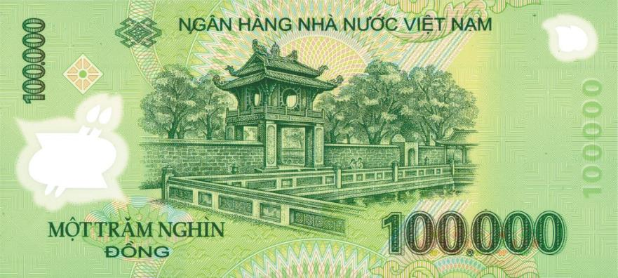
Automatic Alternative Image Recognition to Voice
Problem
How much is it?
Mr. Long

Slide 245
Automatic Alternative Image Recognition to Voice
Our Proposal

Slide 246
Automatic Alternative Image Recognition to Voice
Our Proposal
System

Slide 247
Automatic Alternative Image Recognition to Voice
Our Proposal
Detect Object
System

Slide 248
Automatic Alternative Image Recognition to Voice
Our Proposal
Describe information back to the blind
Detect Object
System

Slide 249
Automatic Alternative Image Recognition to Voice
Our Proposal
Describe information back to the blind
Detect Object
System
The blind know what it is

Slide 250
Automatic Alternative Image Recognition to Voice
Our Proposal
Describe information back to the blind
Detect Object
System
Blind can do right thing with it
The blind know what it is

Slide 251

Automatic Alternative Image Recognition to Voice
How can we do that ?
Camera
System
Clarifai Service
Take picture
Training object and store object information
Identify object

Slide 252

Automatic Alternative Image Recognition to Voice
How can we do that ?
1. Capture Picture
Camera

Slide 253
Automatic Alternative Image Recognition to Voice
How can we do that ?
1. Capture Picture
Camera
System

Slide 254
Automatic Alternative Image Recognition to Voice
How can we do that ?
2. Send Image
1. Capture Picture
Camera
System
3. Response Result
Clarifai Service

Slide 255
Automatic Alternative Image Recognition to Voice
How can we do that ?
2. Send Image
1. Capture Picture
Camera
System
3. Response Result
Clarifai Service
4. Process

Slide 256
Automatic Alternative Image Recognition to Voice
How can we do that ?
2. Send Image
1. Capture Picture
Camera
System
3. Response Result
Clarifai Service
4. Process
5. Describe
Blind user

Slide 257
Automatic Alternative Image Recognition to Voice
Technology

Slide 258

Automatic Alternative Image Recognition to Voice
Technology
Image Recognition system
Detect faces, colors…
Custom training
Search images

Slide 259
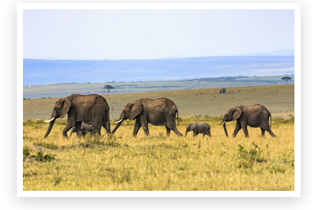
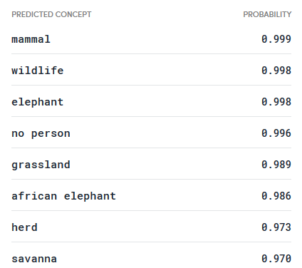
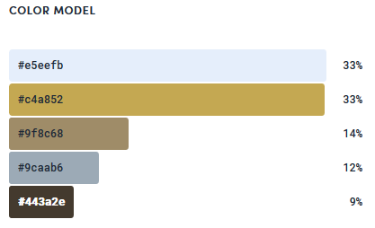
Automatic Alternative Image Recognition to Voice
Technology
Notes:
Neu input la tam nay ---

Slide 260
Automatic Alternative Image Recognition to Voice
Technology
How it works?
Clarifai use a technique called Convolution Neural Networks(CNNs) to object recognition

Slide 261

Automatic Alternative Image Recognition to Voice
Technology
What is Convolution?
Convolution with 3×3 Filter. Source: http://deeplearning.stanford.edu/wiki/index.php/Feature_extraction_using_convolution

Slide 262
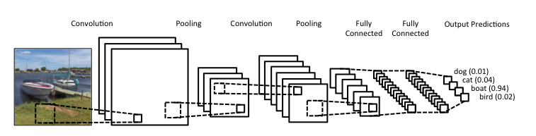
Automatic Alternative Image Recognition to Voice
Technology
Convolutional Neural Networks?
Notes:
Size nho - >nhanh

Slide 263
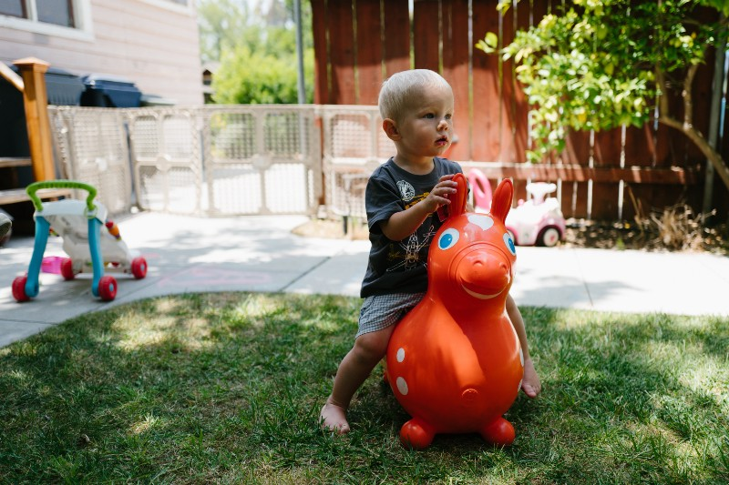
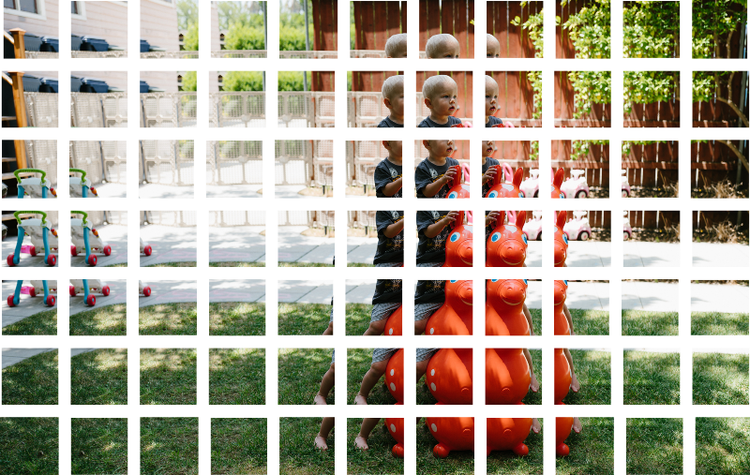
Automatic Alternative Image Recognition to Voice
Technology

Slide 264

Automatic Alternative Image Recognition to Voice
Technology

Slide 265
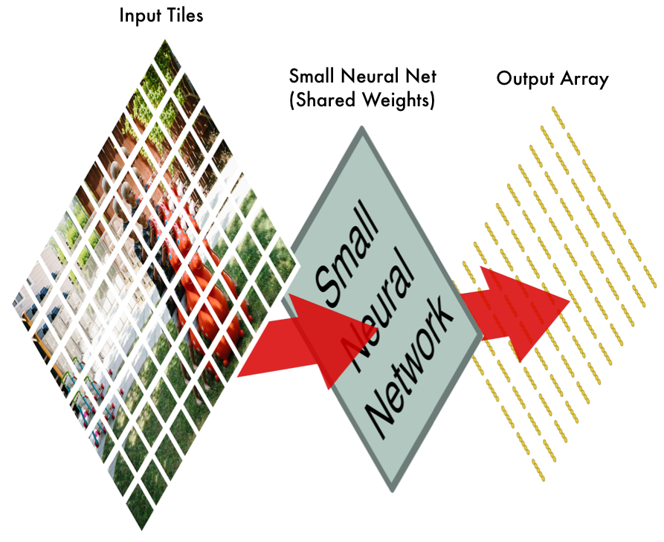
Technology

Slide 266
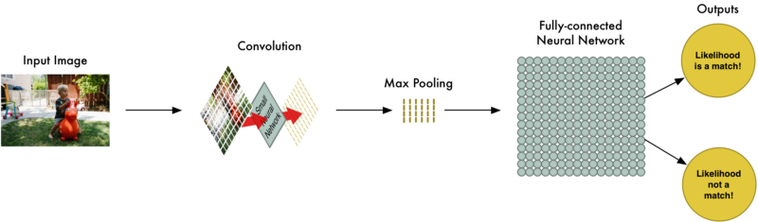
Automatic Alternative Image Recognition to Voice
Technology

Slide 267
Automatic Alternative Image Recognition to Voice
Technology
How can Clarifai service recognitive a things ?

Slide 268
Automatic Alternative Image Recognition to Voice
Technology
Understand Terms
Model
Concept
Input

Slide 269
Automatic Alternative Image Recognition to Voice
Understand Terms
Model
Model: Animal
Model have unique Model ID
Group input(eg. Images, videos) to predictions

Slide 270
Automatic Alternative Image Recognition to Voice
Understand Terms
Concept
Model: Animal
Belong to a unique Model
Have a unique Concept ID
Dog
Cat
Four Legs

Slide 271
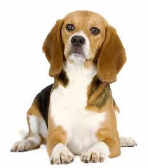
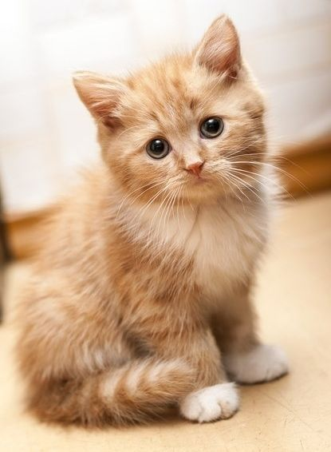
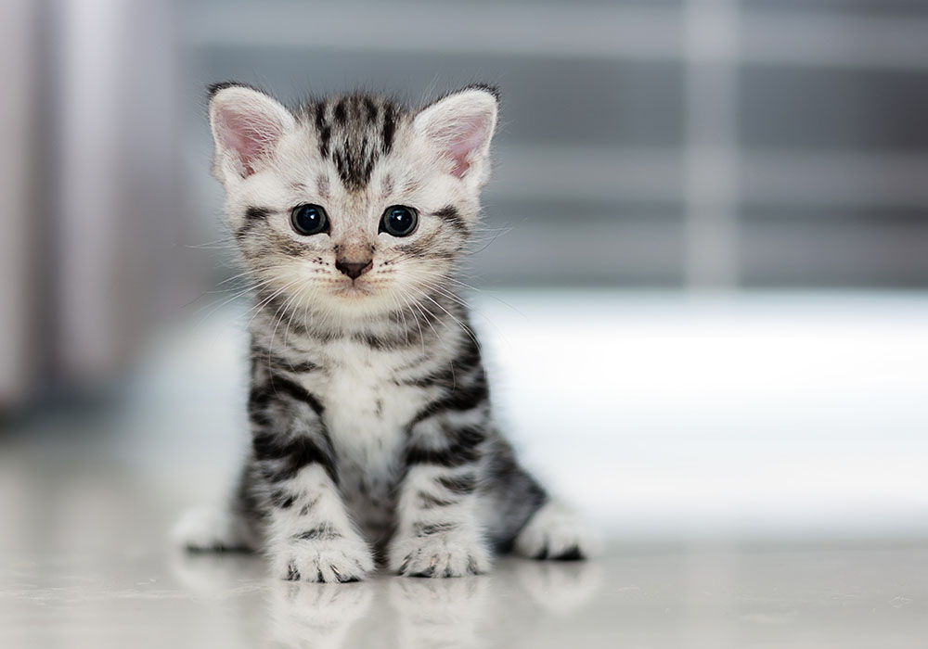
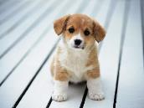
Automatic Alternative Image Recognition to Voice
Understand Terms
Input
Model: Animal
Have a unique Input ID
Have one or many concept
Dog
Cat
Four Legs

Slide 272
Automatic Alternative Image Recognition to Voice
Apply in our system
Model: Capstone
Dog
Cat
…
Search faster
Unnecessary abstract concept(eg. Four legs)
Need exact name of the object

Slide 273
Automatic Alternative Image Recognition to Voice
Technology
Training Process
Create Concept
Add Image to Concept
Training

Slide 274
Automatic Alternative Image Recognition to Voice
Technology
Training Process
Create Concept
Add Image to Concept
Training

Slide 275

Automatic Alternative Image Recognition to Voice
Create New Concept
Clarifai Service
System
Admin

Slide 276
Automatic Alternative Image Recognition to Voice
Create New Concept
Clarifai Service
System
Model
Concept
1. Input
Concept Id
Name
Description
Name
Admin
Description

Slide 277
Automatic Alternative Image Recognition to Voice
Create New Concept
Clarifai Service
System
Model
Model
Concept
Concept
2. Create Concept
1. Input
Concept Id
Name
Description
Concept Id
Name
Name
Admin
Description

Slide 278
Automatic Alternative Image Recognition to Voice
Create New Concept
Clarifai Service
System
Model
Model
Concept
Concept
2. Create Concept
1. Input
Concept Id
Name
Description
Concept Id
Name
Name
Concept ID
Admin
Description
Name
3. Concept information

Slide 279
Automatic Alternative Image Recognition to Voice
Technology
Training Process
Create Concept
Add Image to Concept
Training

Slide 280
Automatic Alternative Image Recognition to Voice
Create New Input
Clarifai Service
System
Model
Model
Concept
Concept
Concept ID
Name
Description
Concept ID
Name
Admin

Slide 281

Automatic Alternative Image Recognition to Voice
Create New Input
Clarifai Service
System
Model
Model
Concept
Concept
1. Input
Concept ID
Name
Description
Concept ID
Name
Admin

Slide 282
Automatic Alternative Image Recognition to Voice
Create New Input
Clarifai Service
System
Model
Model
Concept
Concept
2. Send
1. Input
Concept ID
Name
Description
Concept ID
Name
Admin
Concept ID
Input

Slide 283
Automatic Alternative Image Recognition to Voice
Create New Input
Clarifai Service
System
Model
Model
Concept
Concept
2. Send
1. Input
Concept ID
Name
Description
Concept ID
Name
Admin
Input
Concept ID
Input ID
Input
3. Return
Input ID

Slide 284
Automatic Alternative Image Recognition to Voice
Technology
Training Process
Create Concept
Add Image to Concept
3. Training

Slide 285

Automatic Alternative Image Recognition to Voice
Training
Clarifai Service
System
Model
Model
Admin
Train Model

Slide 286
Automatic Alternative Image Recognition to Voice
Training
Clarifai Service
System
Model
Model
1. Train
Admin
Train Model

Slide 287
Automatic Alternative Image Recognition to Voice
Training
Clarifai Service
System
Model
Model
2. Send
Model ID
1. Train
Admin
Train Model

Slide 288
Automatic Alternative Image Recognition to Voice
Training
Clarifai Service
System
Model
Model
2. Send
Model ID
1. Train
Admin
3. Response
Train Model

Slide 289
Automatic Alternative Image Recognition to Voice
Training
Clarifai Service
System
Model
Model
2. Send
Model ID
1. Train
Admin
3. Response
4. Response
Train Model

Slide 290
Automatic Alternative Image Recognition to Voice
Technology
Training Process
Create Concept
Add Image to Concept
Training

Slide 291



Demo
1. Create Concept
2. Add Image to Concept
3. Training

Slide 292


Automatic Alternative Image Recognition to Voice
Detect Object
Get URL picture
3
1
2
4
Write log
No
Confident rate > 0.6?
4.1.1
4.1
4.2
Get information Obejct
Yes
4.2.1

Slide 293
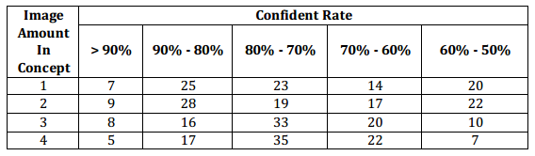
Automatic Alternative Image Recognition to Voice
Detect Object
Why confident rate > 0.6 ??

Slide 294

Demo

Slide 295
Out come

Slide 296
Out come
Problems solved
High precision(up to 90%)
Can identify person & object
The blind can use app by voice

Slide 297
Out come
Problems solved
Limitations
Only available on Android OS
Need internet connection
High precision(up to 90%)
Can identify person & object
The blind can use app by voice

Slide 298
Automatic Alternative Image Recognition to Voice
Future Plan
Support multiple platforms: iOS, Window phone or smart glasses
Improve voice control
Develop new algorithm

Slide 299





Automatic Alternative Image Recognition to Voice
Technologies

Slide 300






Automatic Alternative Image Recognition to Voice
Devlopment Environment

Slide 301
Thank you for listening !

